Slide 2

PROJECT CONTENT
To make it easier to study how the operations on data structure and various algorithms are performed. The data structures can be stack, queue and linked list etc. And algorithms are sorting like bubble sort, insertion sort etc. Aim behind implementation of this project to make a clear understandability of various algorithms of data structures. Using a web page this will simulates the data structure operations such as searching, sorting, insertion, deletion etc. In array, stack, queue, and linked list as well. Thus, our web page provides effective and efficient knowledge of data structures. This also provide some theoretical knowledge regarding the data structure.
Notes:
https://unsplash.com/photos/TvN54bnuQg8

Slide 3

TYPES OF SORTING
MERGE SORT
QUICK SORT
BUBBLE
SORT
INSERTION
SORT
Notes:
https://unsplash.com/photos/AXu2aZ3YgP8

Slide 4

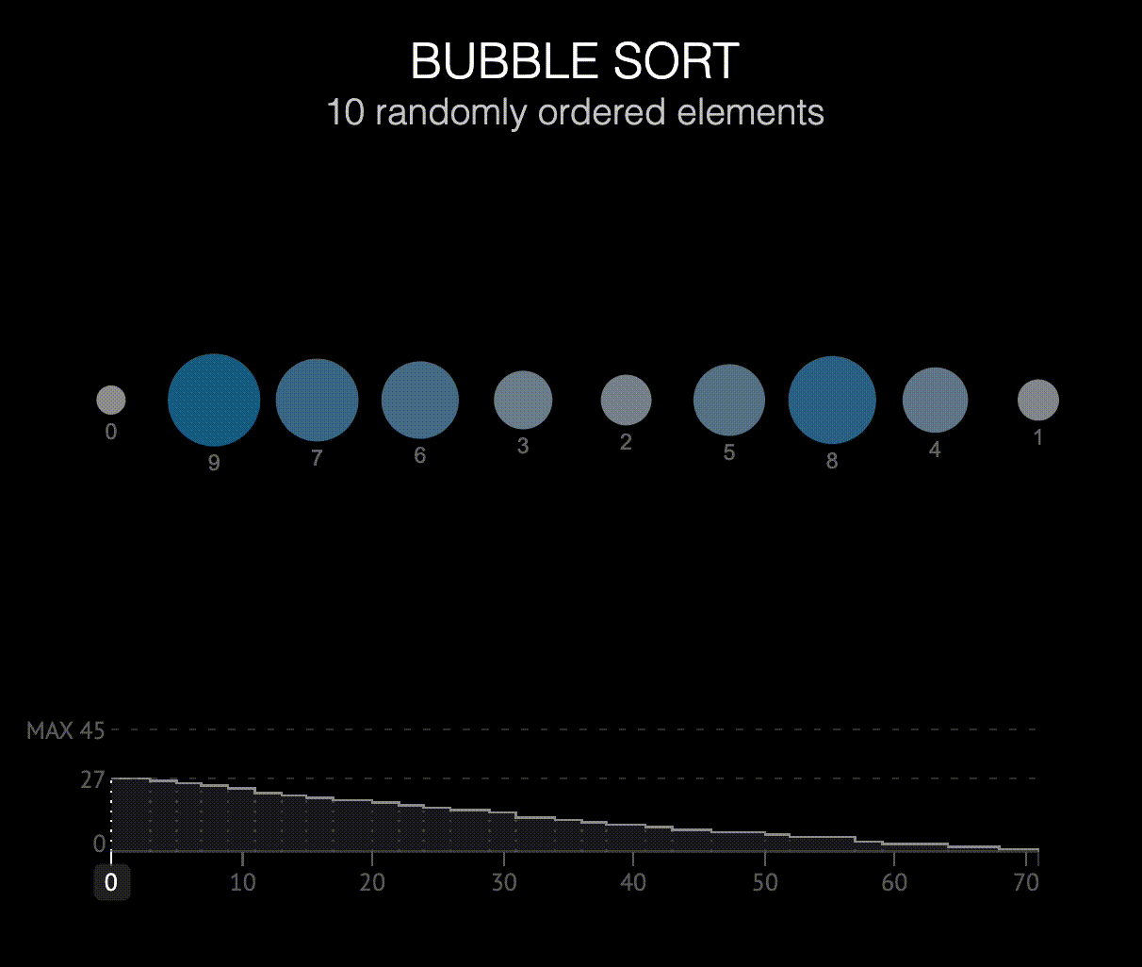


The basic ideal of bubble sorting is that it repeatedly swaps adjacent sorting elements if they are not in desired order.
Notes:
https://unsplash.com/photos/AXu2aZ3YgP8

Slide 5
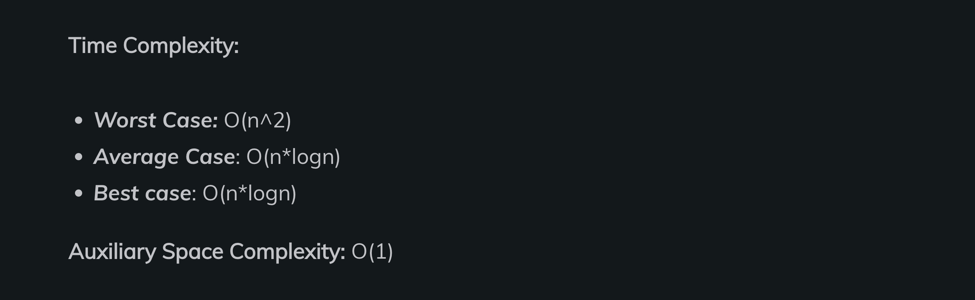
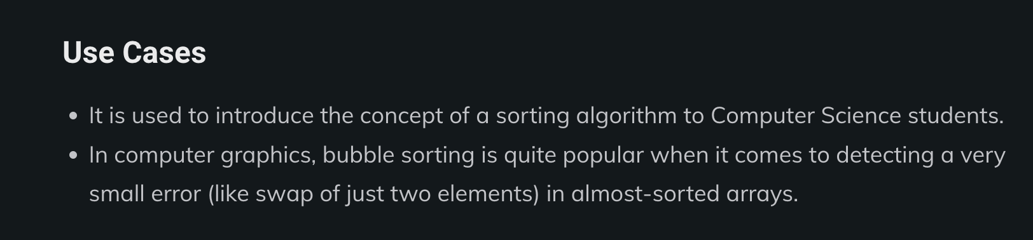
Time Complexity Of Bubble Sort
Notes:
https://unsplash.com/photos/AXu2aZ3YgP8

Slide 6
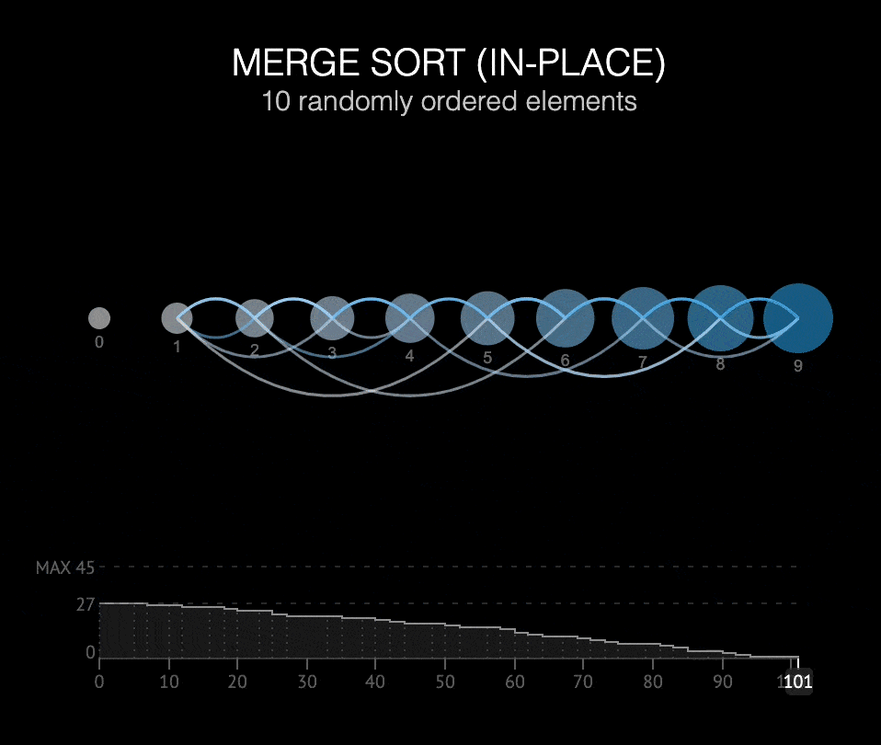
Merge Sort is a divide and conquer algorithm. In each iteration, merge sort divides the input array into two equal subarrays, calls itself recursively for the two subarrays, and finally merges the two sorted halves.

Slide 7
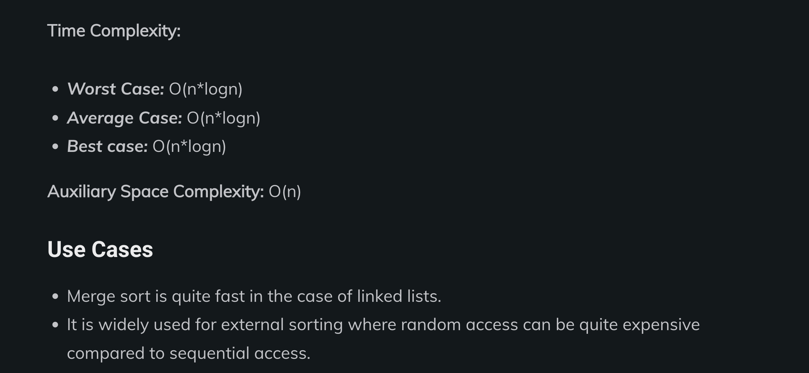
Time Complexity Of Merge Sort
Notes:
https://unsplash.com/photos/AXu2aZ3YgP8

Slide 8
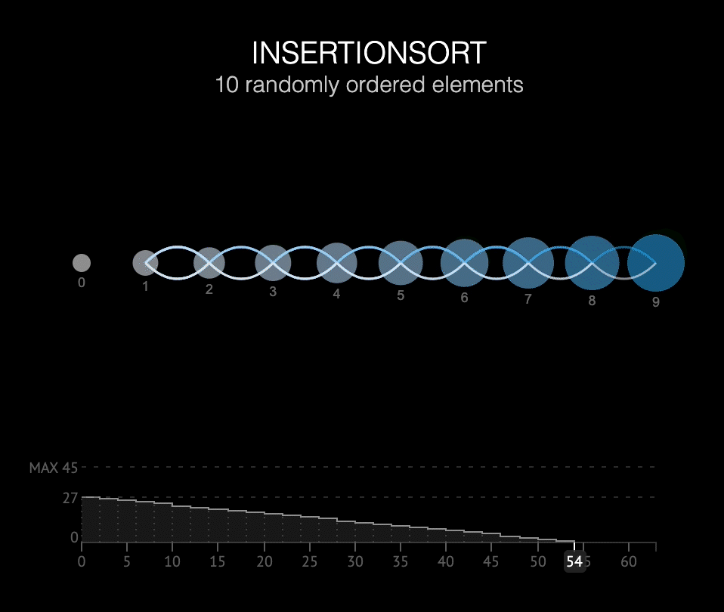
Insertion Sort is a sorting algorithm in which the given array is divided into a sorted and an unsorted section. In each iteration, the element to be inserted has to find its optimal postion in the sorted subsequence and is then inserted while shifting the remaining elements to the right.

Slide 9
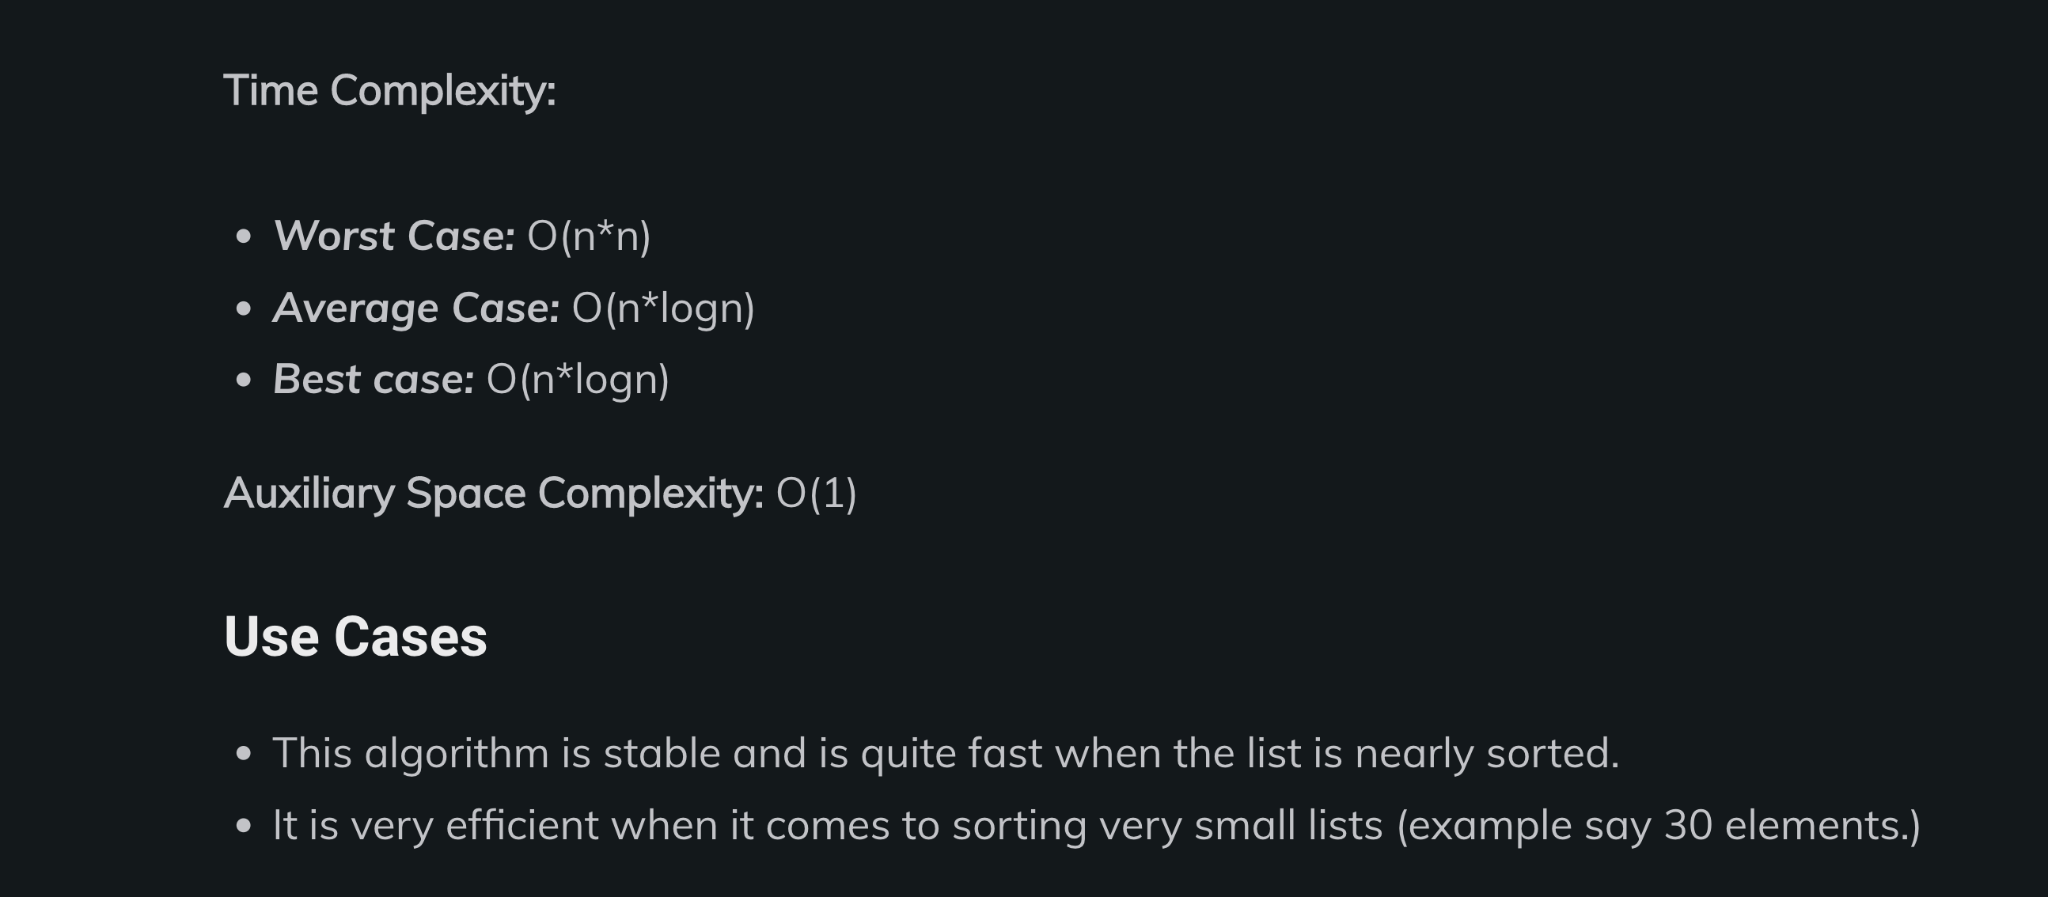
Time Complexity Of Insertion Sort
Notes:
https://unsplash.com/photos/AXu2aZ3YgP8

Slide 10
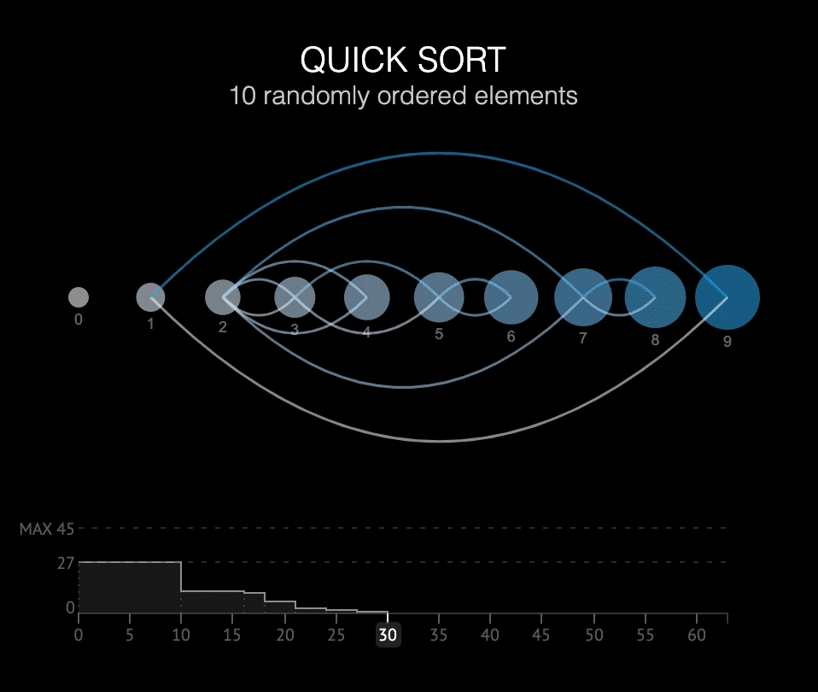
Quick Sort is a divide and conqure algorithm. The intuitive idea behind quick sort is it picks an elements and then partitions the array around the pivot element. Subsequently, it calls itself recursively and partitions the two subarrays thereafter.

Slide 11
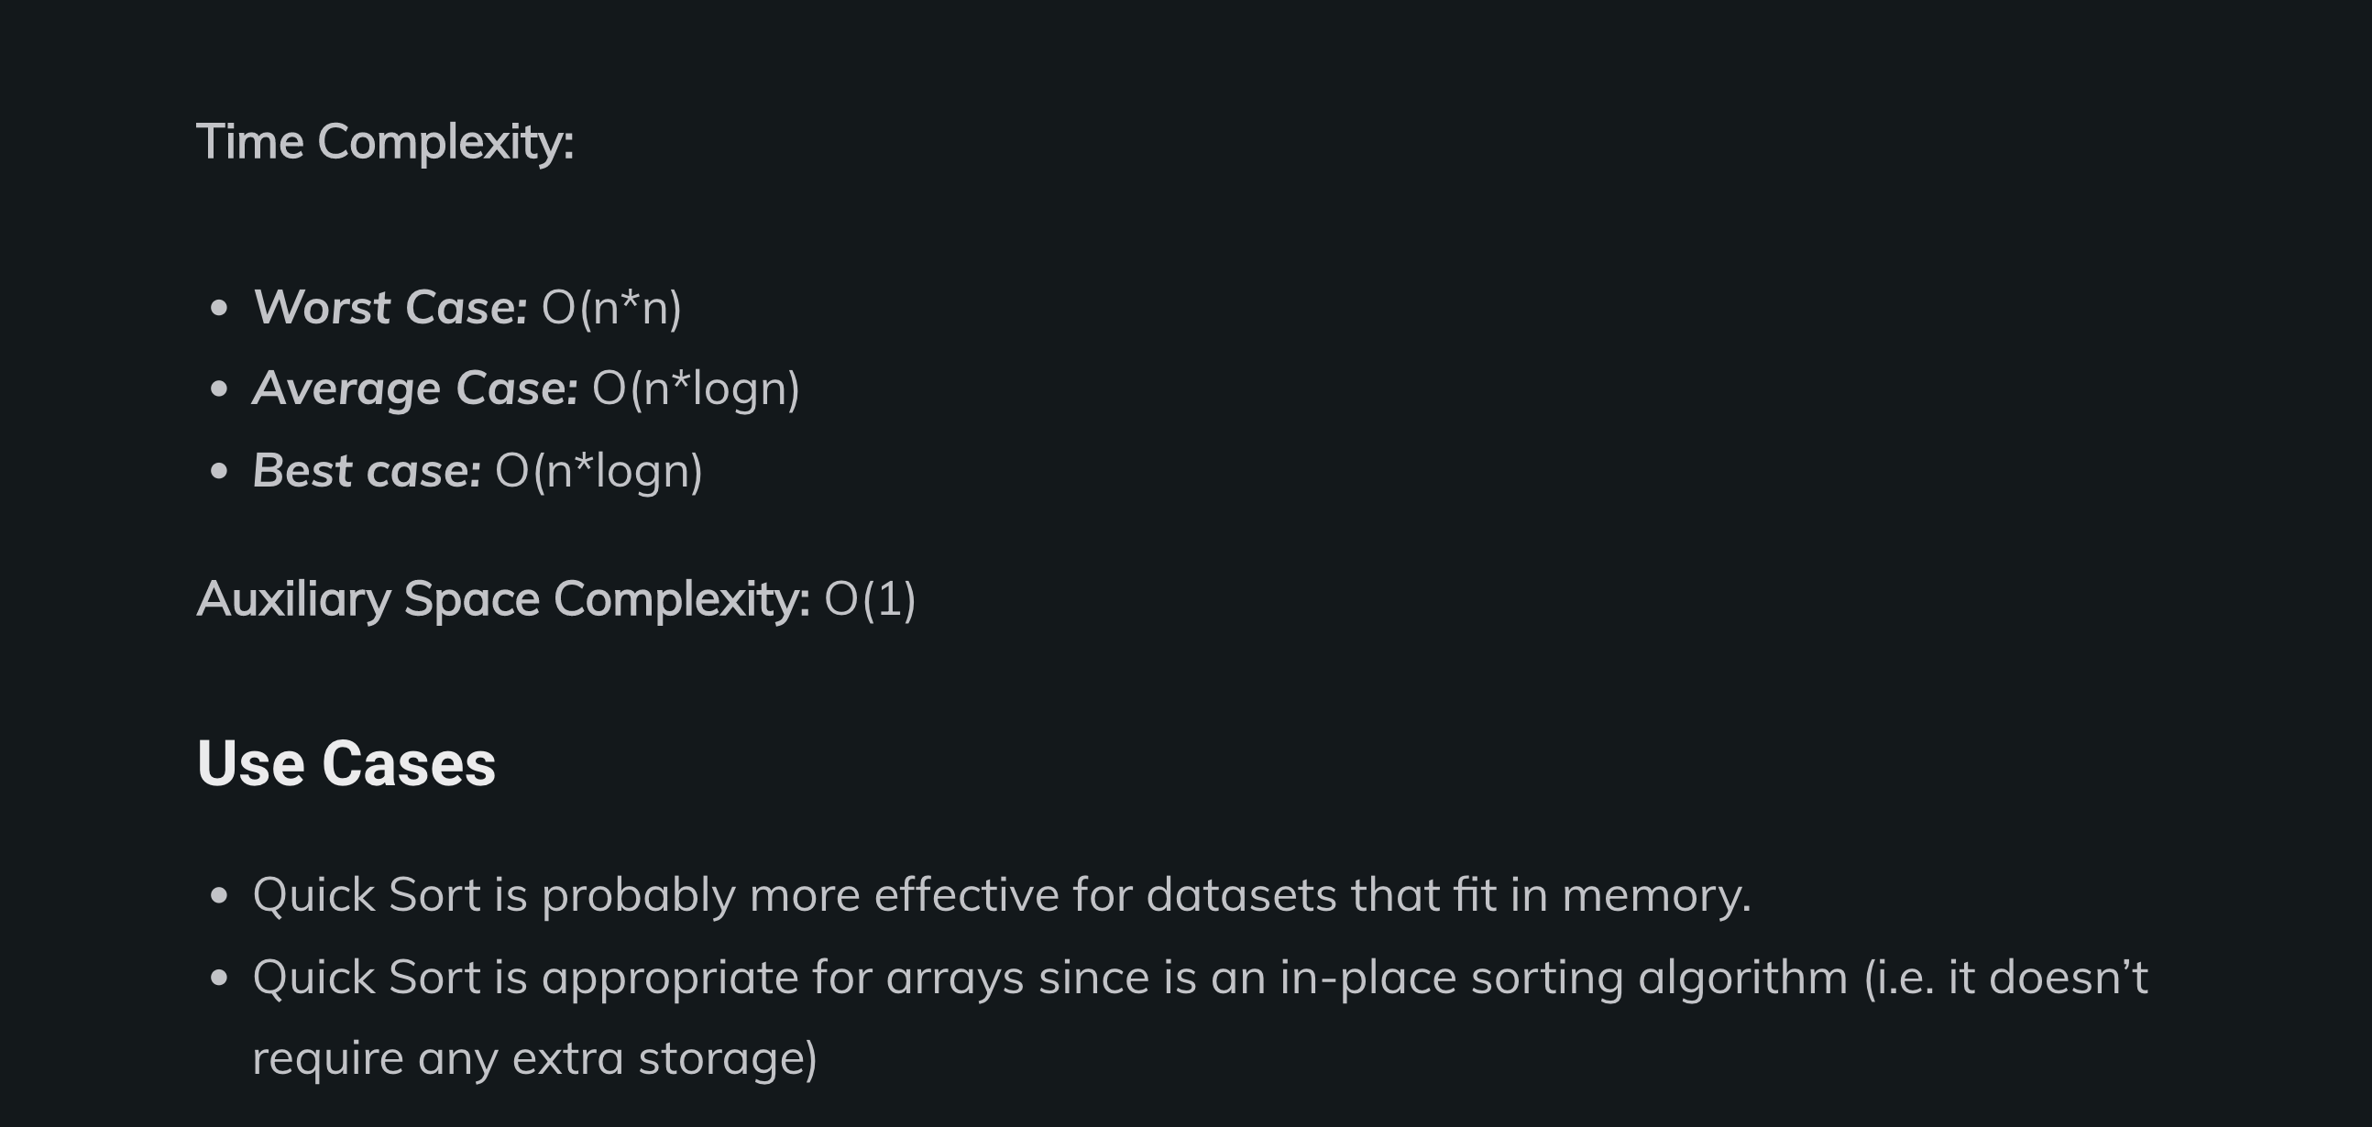
Time Complexity Of Quick Sort
Notes:
https://unsplash.com/photos/AXu2aZ3YgP8

Slide 12
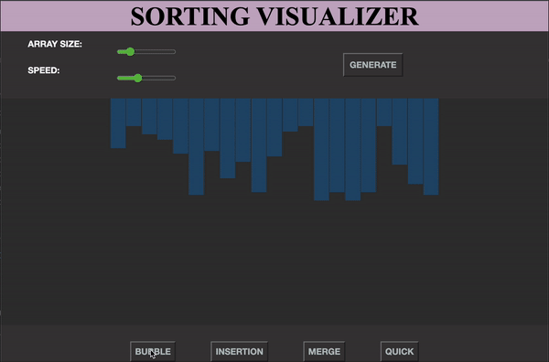
IMPLEMENTATION
The visualizer basically plays with colors to better understand what is happening in the algorithm. The data here is the bars that are generated randomly with arbitrary heights.
When the algorithm runs, these bars or segments change to three different colors yellow, red, and green, each holding its own function.
The yellow segment represents that the algorithm is looking at that particular segment. If it is changing a certain segment it will mark it as red. If the final position of the segment is where it is now that is in a sorted position, it will mark it as green.
Once the algorithm is running, it disables all the buttons so that sorting can be performed uninterruptedly. Color and height are changed accordingly while the algorithm is working.
Notes:
https://unsplash.com/photos/TvN54bnuQg8

Slide 13

CONCLUSION
Through the implementation of Sorting Algorithms in HTML,CSS and JavaScript, Sorting Visualizer was developed to make a clear understandability of various algorithms of data structures.
REFRENCES :-
https://www.crio.do/blog/top-10-sorting-algorithms/
Notes:
https://unsplash.com/photos/GKLIsLZxhj0

